Slide 1

Understanding biologics: A guide to reference and biosimilar biologic medicines
US Version 1.0
August 2024
FA-11233189

Slide 2
Disclaimer
The contents of this training were co-created with and approved by an international advisory committee of experts in MS nursing and nurse education, sponsored by Sandoz
Please note that as nurse roles, responsibilities and naming conventions differ between geographies, the general term of ‘nurse’ has been applied throughout
This training has been localized and approved for use in the United States to provide biosimilar training to MS nurses and other relevant stakeholders specifically in the US, however, for completeness and wider context, some international references are used
For more detailed information on an individual product, please check and consider the locally approved prescribing information of the respective drug

Slide 3

Learning objectives
On completion of this module, you should be able to:
Distinguish between the different pharmaceutical treatment groups used in MS
Describe important biologic medicine concepts including inherent variability
Explain basic biosimilar medicine concepts
Teach about the development and approval of biosimilar medicines
Educate on the impact of biosimilar medicines in healthcare systems using real-world examples

Slide 4




Overview
Total estimated completion time: 60 min
Click on each title below to view the corresponding section
Treatment groups in MS: A closer look at biologic reference and biosimilar medicines
15 min
Biosimilar medicines: How long have they been around and why are they used?
10 min
The development and approval of biosimilar medicines
20 min
Key takeaways
05 min
How much do you know about biologic and biosimilar medicines now?
Try the self-assessment quiz to test your knowledge!
10 min

Slide 5
Treatment groups in MS:
A closer look at biologic reference and biosimilar medicines

Slide 6

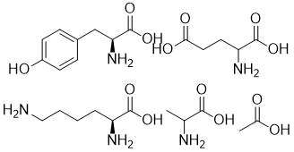
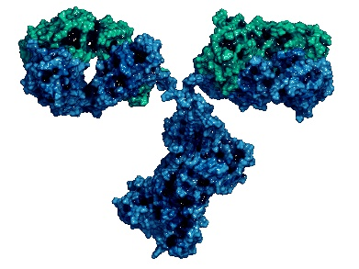
Biologic medicines are one of three distinct pharmaceutical medicine groups used to treat MS
Small molecule medicine^{1–4}
Non-biological
complex drug (NBCD)^{1–4}
Biologic medicine^{1–4}
Example: Teriflunomide^{5,6}
Example: Glatiramer acetate^{10,11}
Example: Natalizumab^{13,14}
Production: Chemical synthesis
Production: Chemical synthesis
Production: Living cells or organisms, mammalian cells
Molecular composition: Complex and large composition made of single/multiple active substance(s)
Successor: Biosimilar medicine
  Because of the inherent variability of all biologics, it is not possible to create an identical version of a biologic medicine, even between reference medicine batches. Successors to a reference biologic medicines are called 'biosimilars’ that match their reference medicine in terms of safety and efficacy⁷
  Example: Biosimilar natalizumab^{15,16}
Molecular composition: Single well-defined molecule
Molecular composition: Multiple molecules
of different sizes
Successor: Generic small molecule medicine
  A generic small molecule medicine is a copy of a reference small molecule medicine for which the patent has run out. Identical copies can be made due to the simple chemical composition of small molecule medicines⁷
  Example: Generic teriflunomide^{8,9}
Successor: Generic NBCD
  A generic NBCD is a successor to a reference NBCD for which the patent has run out. Generic NBCDs will not be identical to their reference NBCD due to their complex chemical composition⁷
  Example: Generic glatiramer acetate¹²
Notes:
Small molecule medicines are low-weight compounds created through chemical synthesis, which is the process of making new chemicals by combining simpler substances through chemical reactions. Small molecule medicines consist of a single, well-defined molecule that can be precisely replicated synthetically. Examples of small molecules include cladribine, siponimod, ozanimod and ponesimod
NBCDs are made synthetically, like small molecule medicines, but have a complexity similar to biologics, requiring strict manufacturing processes for consistent quality, safety, and effectiveness. Glatiramer acetate is an example of NBCD, although it is often mis-classified as a biologic medicine.
When the patent and exclusive rights for a branded medicine expire, other medicines that contain the same chemical substance or active ingredient as the ‘original’ medicine can be created. For small molecules and NBCDs, these ‘successors’ are known as generic medicines. For biologic medicines, successors are called biosimilar medicines.

Slide 7
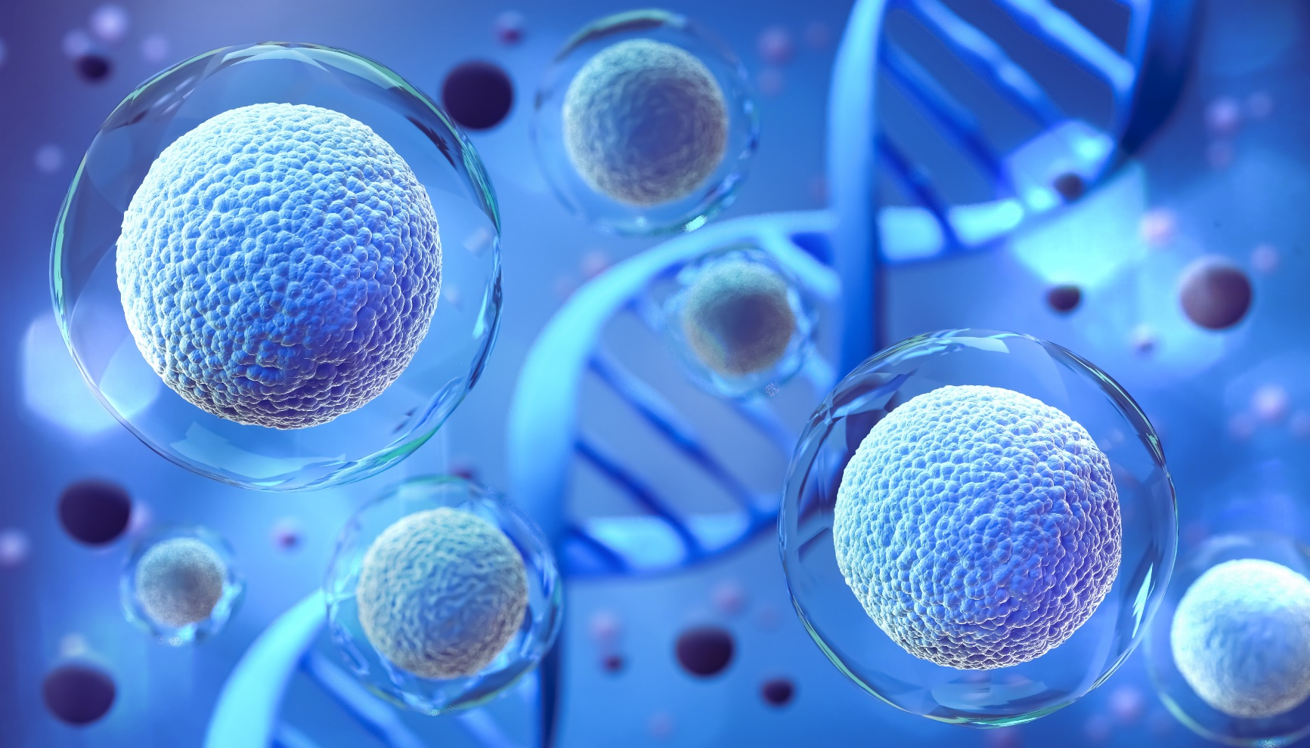
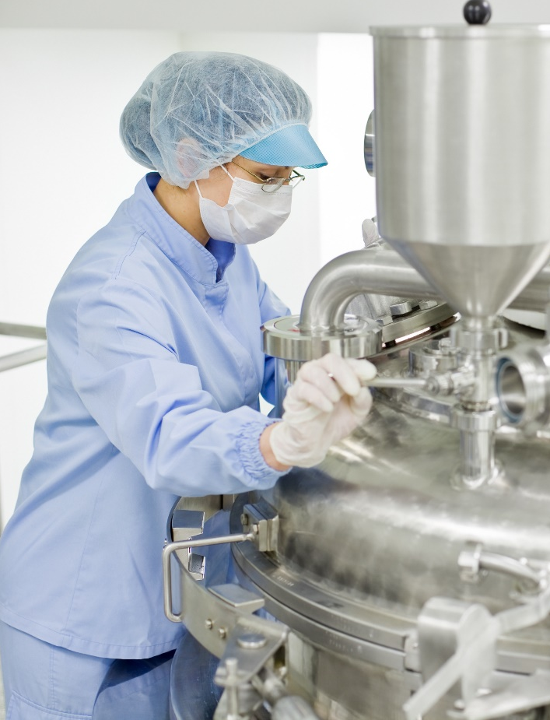
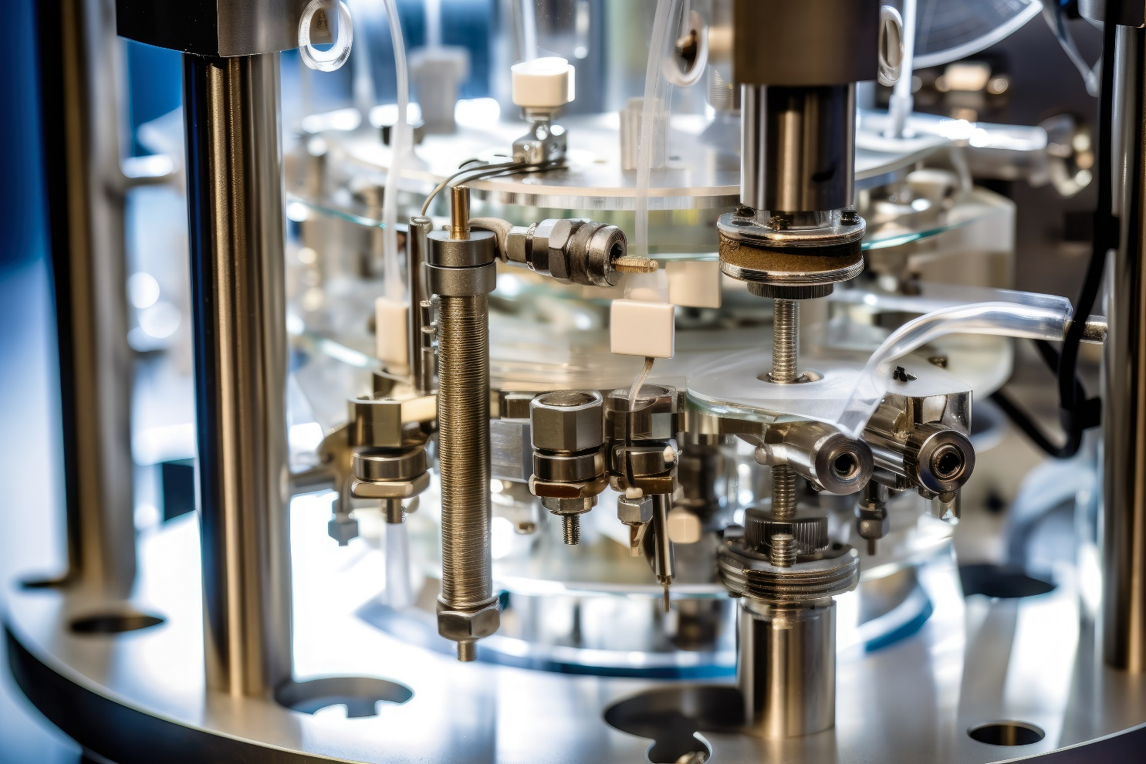
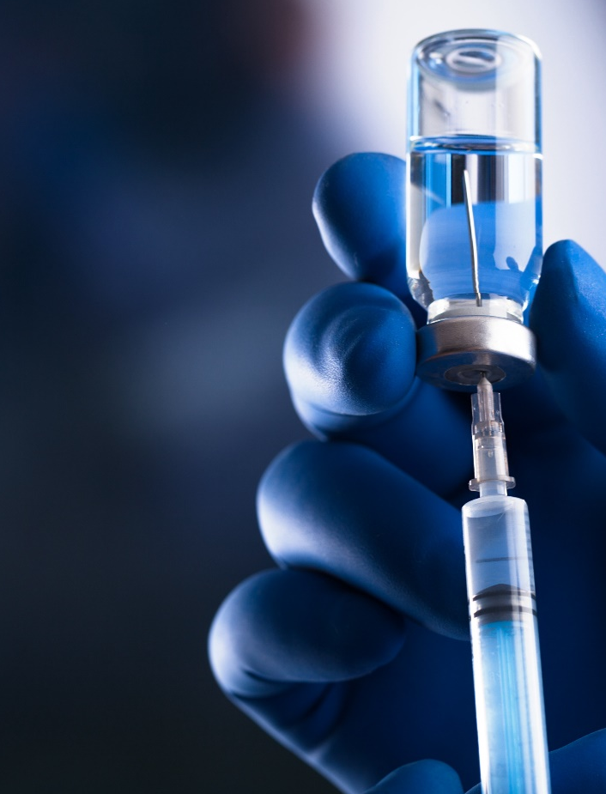



Biologic medicines have a complex development process
Biologic medicines are made from living organisms, such as mammalian cells, bacteria or yeast^{1,2}
Biologic medicines are typically characterized by their larger size and higher complexity compared with chemically synthesized compounds¹
Modify host cells
Grow cells
Extract, refold, purify
Formulate to stable
finished drug product
(e.g. bacteria, yeast, mammalian) to produce recombinant proteins^{1–3}
under controlled
conditions (fermentation, upstream process)^{2,3}
to generate drug substance (downstream process)³
vial, syringe, cartridge³
Notes:
Natalizumab, ocrelizumab and alemtuzumab are examples of biologic medicines used for the treatment of relapsing forms of multiple sclerosis

Slide 8
Variability is in the nature of all biologic medicines
The living organism
(biologic system) has built-in inherent natural variability (microheterogeneity)¹
Variability is tightly controlled to be within acceptable limits¹
Inherent
variability
The complex manufacturing
process adds to this inherent variability. Variability is a normal principle in protein manufacturing^{1,3}
Manufacturing variability
Example of inherent variability:
Within-batch variability of a VEGF-A inhibitor biologic medicine²
Example of manufacturing
variability: Batch-to-batch variability
of an anti-CD20 biologic medicine⁴
154
2.0
152
The within-batch standard deviation ranged from
0.294 to 2.07 (coefficient of variation from 0.26% to 1.38%)
1.6
Pre-change batches*
Post-change batches*
150
1.2
Molecular weight (kDA)
G0 glycan (rel. area %)
*Change in quality profile due to revised manufacturing process
148
0.8
146
0.4
144
0
1
2
3
4
5
6
7
08.2007
12.2008
05.2010
09.2011
Batch
Expiry date
Figure from: Oliva A, Llabrés M. Pharmaceuticals 2021;14(527):1–10.
Figure from Schiestl M, et al. Nat Biotechnol 2011;29:310–312.
Notes:
All biologic and biosimilar medicines are produced from living cells, which naturally vary. As a result, the active substance in the medicine may have slight variations, known as ‘inherent variability’
This variability means that there can be structural differences between batches of the same biologic medicine, between a biosimilar medicine and its reference, and between different batches of the same biosimilar medicine
These minor differences are not clinically meaningful as they are monitored during production of the medicine
The manufacturing process is controlled to ensure that the resulting active substance falls within an acceptable range of the reference medicine

Slide 9

Biologic medicines can provide targeted treatment for many diseases
The active substance of a biologic medicine is made to interact exactly with a specific target in the human body. Biologic medicines include vaccines, recombinant proteins, monoclonal antibodies, and blood derivatives^{1–4}
Since the approval of the first biologic human insulin (Humulin®) in 1982,⁵ biologic medicines have revolutionized the treatment of many diseases^{2,3,6,7}
Anemia
Inflammatory bowel disease
Psoriasis
Cancers
Multiple sclerosis
Rheumatoid arthritis
Diabetes

Slide 10

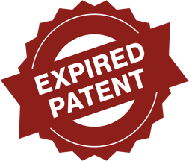

Biosimilar medicines are successors to reference biologic medicines
A biosimilar medicine is a successor to a reference biologic medicine (also known as the “reference medicine”) for which the patent and exclusivity period have expired¹
Based on a comprehensive ‘totality of evidence’ data package, EMA and US FDA approvals confirm that there are no clinically meaningful differences in terms of efficacy, safety, and immunogenicity of a biosimilar compared to its EMA/US FDA-approved reference medicine^{2,3,4}
Biosimilar medicines are approved based on the same standards of pharmaceutical quality, safety, and efficacy as their reference medicine^{2,3,4}

Slide 11
Biosimilar medicines:
How long have they been around and why are they used?

Slide 12
A brief history of biosimilar medicine approvals worldwide
55 biosimilars approved
by EMA¹
74 biosimilars approved
by EMA⁶
76 biosimilars approved
by EMA⁶
First biosimilar approved
by EMA¹
First biosimilar approved by Japan PMDA³
First biosimilar approved by US FDA¹
22 biosimilars approved by Japan’s PMDA⁵
16 biosimilars approved by US FDA¹
40 biosimilars approved by US FDA⁷
45 biosimilars approved by US FDA⁷
Brand: Omnitrope® (somatropin)²
Company: Sandoz²
Treatment area:
Growth hormone deficiency²
Brand: Somatropin BS® (somatropin)³
Company: Sandoz³
Treatment area:
Growth hormone deficiency³
Brand: Zarxio®
(filgrastim-sndz)⁴
Company: Sandoz⁴
Treatment area: Neutropenia⁴
2006
2009
2015
2019
2021
2022
2023*

Slide 13
What do biosimilars mean for healthcare systems?
Biosimilar medicines have been shown to result in cost savings and increased treatment access in different therapy areas
Gastroenterology
A study in adult patients with IBD showed that¹:
  97% of patients successfully switched to biosimilar infliximab, and 83% of patients were still using biosimilar infliximab
  12–15 months after the switch
  Estimated annual savings of around $500,000 at a major US medical center
Oncology
In the US, biosimilar filgrastim gained widespread adoption, with ~ 50% of filgrastim claims in Medicare and ~39% in Medicaid populations²
The introduction of biosimilar filgrastim in the European Union led to 44% increase in patient access between 2006 and 2013³
The introduction of biosimilar G-CSF medicines has had the following impacts:
  5-fold increase in the use of a reimbursed G-CSF biologic medicine in Sweden⁴
  Decrease in hospitalizations for chemotherapy-induced febrile neutropenia in breast cancer from 33% to <7% in New Zealand⁵
Rheumatology
The introduction of biosimilar TNF-α inhibitors for rheumatoid arthritis in Europe led to⁶:
  A 19% increase in the use of TNF-α inhibitors per treatment day, compared with 1 year prior to their market release
  A 13% decrease in the price of treatment per day, compared with 1 year prior to their market release
G-CSF, granulocyte colony-stimulating factor; IBD, inflammatory bowel disease; TNF, tumor necrosis factor.
1. Bhat S, et al. J Manag Care Spec Pharm 2020;26(4):410–416; 2. Qian J. J Manag Care Spec Pharm 2021;27(5):660–666; 3. Medicines for Europe. Factsheet on biosimilar medicine. Available at: https://www.medicinesforeurope.com/wp-content/uploads/2016/04/6.-Biosimilar-Medicines_On-Biosimilar-Medicines.pdf. Accessed December 2023; 4. Gascon P, et al. Support Care Cancer 2013;21:2925–2931; 5. Cornes P, et al. BioDrugs 2020;34:255–263; 6. Smolen JS, et al. RMD Open 2019;5:e000900.

Slide 14
The development and approval of biosimilar medicines

Slide 15
Biosimilar medicines offer continuity of care
Reference medicine
Biosimilar medicine
via the
and the
Same
active
substance
Same
route
Same
dose
Same
indications
at the

Slide 16

The approval and manufacture of biosimilar medicines in Europe and the US is strictly regulated^{1–4}
Regulatory bodies such as the EMA and the US FDA will only approve a biosimilar if it is demonstrated that the biosimilar matches the reference medicine in terms of quality, safety and efficacy, with no clinically meaningful differences in immunogenicity^{2,3}
EMA
US FDA
  Comparable safety and efficacy of a biosimilar to its reference product has to be demonstrated or otherwise justified in accordance with the data requirements laid down in Directive 2001/83/EC^{3,4}
  “All FDA-approved biologics undergo a rigorous evaluation to ensure their
  safety, effectiveness, and quality.”
  “The approval process provides
  assurance that biosimilars provide the same treatment benefits as their
  respective reference products”⁵
As for all biologic medicines, once biosimilars are approved by regulatory agencies and enter the market,
their safety profile continues to be monitored throughout the medicine’s life cycle^{2,6}
Notes:
An approved biosimilar medicine is expected to provide the same treatment benefits and clinical outcomes as its reference biologic. ‘No clinically meaningful differences’ is a regulatory phrase used to indicate that slight differences between a biosimilar medicine and its reference biologic might exist due to inherent variability; however, these slight differences do not have an impact on the clinical efficacy and safety of the biosimilar medicine.

Slide 17


Reference and biosimilar biologic medicines provide the same clinical and safety outcomes for patients
Biosimilar and reference medicines^{1,2,3}:
1. Same active ingredient
2. Produced to the same standards
Reference medicine
Biosimilar medicine
3. Comparable safety and efficacy
Similar to the original key and a replica of the key that a locksmith can make, an approved biosimilar medicine and its reference medicine can be expected to have the same clinical and safety outcomes^{2,3,4}

Slide 18
Biosimilar medicines are developed to match an already approved reference biologic medicine
Reference biologic
A reference biologic has a novel active substance, so data for its development and approval focus on understanding its mode of action and effect on a particular disease¹
Biosimilar medicine
A biosimilar medicine is developed via a systematic and robust development process to be highly similar to an existing approved reference biologic. As mode of action is already known, the data focus on showing if the biosimilar molecule matches the reference molecule^{2,3}
Structure of the molecule
Function – binding to the target
PD – what the medicine does in the body
Efficacy – the treatment effect
Biosimilar medicine
250
25
Reference medicine
30
Reference medicine (n=102)
Biosimilar medicine
25
Biosimilar medicine (n=97)
Reference medicine (US)
200
20
1D-{1H}-nuclear magnetic
resonance spectra
150
15
20
Receptor binding affinities
Relative response (RU)
Time course of recovery
ANC (10⁹/L)
Geometric mean ANC (x10⁹/L)
15
Reference medicine (EU)
100
Reference medicine
(EU and US)
10
10
50
Biosimilar medicine
5
5
10
9
8
7
6
5
4
3
2
1
0
0
0
200
400
600
800
1000
1200
1400
0
0
20
40
60
80
100
120
0
1
5
10
15
21
ppm
Time (sec)
Nominal time (hours)
Day
Figures reproduced from Sorgel F, et al. BioDrugs 2015;29(2):123–131; Blackwell K, et al. Ann Oncol 2015;26(9):1948–1953.
Once the physical and chemical properties of the biosimilar and reference molecules have been shown to match, the clinical effects of the biosimilar medicine can be expected to match those of the reference biologic. This can be further confirmed with clinical studies^{2,3}

Slide 19
Biosimilar medicines are approved based on the
‘Totality of Evidence’ data package^{1,2,3}
Reference product development:¹
Prove that new molecule has significant clinical benefit
Biosimilar development:^{2,3}
Demonstrate that molecule is highly similar to reference product
Preclinical / Toxicity Assessment*
Analytical characterization
PK/PD
Clinical studies
PK/PD
Preclinical / toxicity assessment
Tailored clinical studies program
Substantial clinical program
Extensive analytical
characterization
Analytical
characterization
Notes:
The development of reference medicines and biosimilar medicines is based on a strict and robust manufacturing process and provides the same level of confidence with regard to the safety and efficacy of the biologic
The data package, known as the Totality of Evidence, is reviewed by European and US regulatory agencies to approve a biosimilar medicine
Once biosimilarity has been demonstrated, the proposed biosimilar medicine is considered to have the same clinical effect as the reference medicine
The analytical assessments are crucial for biosimilar approval. They use sensitive and state-of-the-art methods to confirm that the biosimilar medicine's molecule is an identical amino acid sequence and indistinguishable higher-order structures to the reference medicine
Analytical characterization serves to demonstrate that a biosimilar medicine is structurally and functionally similar to the reference medicine and so can be expected to behave in the same way in the body
For further information of the individual aspects/studies that make up the Totality of Evidence, please refer to the Glossary Infographic

Slide 20
Extrapolation: A biosimilar can be used for all approved reference medicine indications
Reference medicine
Biosimilar medicine
Extrapolation is the scientific and regulatory process of granting a clinical indication to a medicine without conducting a clinical safety and efficacy study to support that indication^{1,2,3}
Extrapolation is regularly applied for any biologic medicine to maintain approval after major changes in the manufacturing process or to introduce and approve new formulations³
A reference medicine manufacturer must show that its product is safe and effective for each indication for which approval is sought¹
If biosimilarity is demonstrated for at least one of the reference medicine’s indications, it is possible to use data and information to scientifically justify approval for other indications¹
Indication 1
Indication 2
Indication 3
Indication 1
Indication 2
Indication 3
Studied and approved indications
Studied and
approved indication
Extrapolated and
approved indications
Extrapolation can be applied to obtain approval after major changes in the manufacturing process (e.g. changes to the mode of administration of a biologic medicine)³
Extrapolation is applied to obtain approval in all the indications that the reference medicine is approved in without conducting clinical trials in each of those indications^{1,2,3}
Notes:
Extrapolation is the process of granting clinical use to medicine without new clinical trials, relying on quality assessments and laboratory studies for one indication
The biosimilar molecule matches the reference molecule, confirmed through the Totality of Evidence. Thus, the biosimilar is expected to behave similarly to the reference molecule in all approved indications and patient populations

Slide 21
Treatment switching
The term ‘switching’ can be used to describe the process by which a prescriber decides to exchange one medicine for another medicine with the same therapeutic intent¹
Switching can occur from:^{2–4}
Rationale behind treatment switch:¹⁻⁷
1
One medicine to another with a different active substance and/or mode of action
Switching to improve patient outcomes
2
A biologic reference medicine to its biosimilar medicine
Switching can occur to decrease treatment costs and improve patient access while maintaining treatment efficacy
3
A small molecule medicine to its generic medicine
4
One biosimilar to another biosimilar of the same reference biologic medicine
5
One generic to another generic version of the same medicine

Slide 22


Switching between reference and biosimilar medicines is safe and effective
If a patient is already being treated with a biologic medicine, they can be switched to its biosimilar medicine as…^{1,2}
…biosimilar medicines approved by the EMA or US FDA can be considered safe and effective treatment options, similar to any other approved medicine^{1,2,3}
The decision to replace a patient’s medicine with another with the same therapeutic intent is at the discretion of the treating physician or nurse practitioner (geography dependent)^{1,2}
An extensive systematic review and meta-analysis of 31 unique studies for 21 biosimilars (N=5,252) by the FDA found
similar safety and immunogenicity rates in patients who were switched to or from a biosimilar medicine, compared to those who remained on a reference medicine or biosimilar across various biosimilars and therapeutic areas^{4*}

Slide 23
The nocebo effect can impact treatment outcomes
.
The nocebo effect can be defined as the opposite of the placebo effect, involving unpleasant or adverse outcomes caused by the treatment setting, independent of any actual pharmacologic impact of the treatment^{1,2}
It occurs when a person’s negative expectations, beliefs, stress, or anxiety about a treatment or procedure can lead to side effects or worsened symptoms, potentially reducing the effectiveness of that treatment^{3–7}
  A nocebo effect can be precipitated by, for example, how an HCP explains the possible side effects of that treatment⁸
In the Framingham Heart Study (1965-1967) in 749 women aged 45-64, a psychosocial questionnaire inquired on the belief one is likely to suffer a heart attack; for those more likely to believe the relative risk was 3.7 (95% CI 1.3-10.3) and those as likely had a relative risk of 0.9 (95% CI 0.3-3.0)^{5*}
  This suggests that a person's own beliefs and emotional states can potentially trigger a negative health outcome, akin to a self-induced nocebo effect^{2,4}

Slide 24

Nurses play a crucial role in mitigating the nocebo effect
Nurses and other HCPs directly involved in patient care play a crucial role in mitigating the nocebo effect when a patient is introduced to a new treatment,^{1–5}
for example, when switching from a reference medicine to its biosimilar⁶
Educating nurses about new treatments, including biosimilars, to build confidence in these treatments’ safety and efficacy, enables them to appropriately convey treatment information to patients^{1–5}
Fostering an empathetic and positive attitude can contribute to creating
a supportive therapeutic environment that reduces the risk of facilitating a
nocebo effect^{1,3,4}
Effective verbal and non-verbal communication can positively influence patient perceptions and responses to a new treatment^{1–3,5}

Slide 25
Key takeaways

Slide 26


Reference and biosimilar biologic medicines:
An overview
All biologic medicines, whether reference or biosimilar medicines, are made by or extracted from living organisms, tissues or cells¹
Due to their biological nature and complex manufacturing process, there is a degree of inherent variability in all biologic medicines – no two batches of any biologic are 100% identical²
‘Biosimilarity’ is established through a comprehensive process based on comparisons between the biosimilar and the reference biologic in terms of quality, efficacy, and safety.³ Therefore, physicians and patients can expect the same clinical outcome when using the reference or biosimilar⁴
Switching from a reference to its biosimilar medicine can be based on factors such as improving patient access to treatment, and sustainability of care^{5–7}
As with many treatments, patients may experience the nocebo effect when prescribed a biosimilar medicine. In this context, the risk of a nocebo effect can be mitigated by educating nurses and patients on the comparable clinical outcomes between reference and biosimilar biologic medicines^{8–10}

Slide 27
How much do you know about biologic and biosimilar medicines now?
Try the self-assessment quiz to test your knowledge!

Slide 28
1
Biologic medicines are chemically synthesized and complex to manufacture
True
False
28

Slide 29

1
Biologic medicines are chemically synthesized and complex to manufacture
True
False
Click here to re-review the content
29
29

Slide 30
2
Minor variation between two batches of the same biologic medicine is
not expected
True
False
30

Slide 31
Minor variation between two batches of the same biologic medicine is not expected
2
True
False
Click here to re-review the content
31

Slide 32
Biologic reference medicines are a separate treatment group to small molecule medicines, NBCDs or generics
3
True
False
32
NBCD, non-biological complex drug.

Slide 33
Biologic reference medicines are a separate treatment group to small molecule medicines, NBCDs or generics
3
True
False
Click here to re-review the content
33
NBCD, non-biological complex drug.

Slide 34
In what way(s) do biosimilar medicines match a reference biologic?
4
Produced to the same standards
Comparable safety and efficacy
Same active ingredient
All of the above
34

Slide 35
In what way(s) do biosimilar medicines match a reference biologic?
4
Produced to the same standards
Comparable safety and efficacy
Same active ingredient
All of the above
Click here to re-review the content
35

Slide 36
For regulatory approval, a biosimilar medicine must match its reference biologic in terms of______?
5
Quality, safety, and immunogenicity
Immunogenicity, safety, and efficacy
Quality, immunogenicity, and efficacy
Quality, safety, and efficacy with no clinically meaningful differences in immunogenicity
36
36

Slide 37
For regulatory approval, a biosimilar medicine must match its reference biologic in terms of______?
5
Quality, safety, and immunogenicity
Immunogenicity, safety, and efficacy
Quality, immunogenicity, and efficacy
Quality, safety, and efficacy with no clinically meaningful differences in immunogenicity
Click here to re-review the content
37
37

Slide 38
When was the first biosimilar medicine approved in Europe?
6
1998
2006
2015
2022
38

Slide 39
When was the first biosimilar medicine approved in Europe?
6
1998
2006
2015
2022
Click here to re-review the content
39

Slide 40
Choose the correct order for the development process of biosimilar medicines
7
Clinical, analytical, PK/PD, preclinical / toxicity assessment
Analytical, preclinical / toxicity assessment, PK/PD, clinical
None of the above
Preclinical / toxicity assessment, PK/PD, analytical, clinical
None of the above
40
PD, pharmacodynamic; PK, pharmacokinetic.

Slide 41
Choose the correct order for the development process of biosimilar medicines
7
Clinical, analytical, PK/PD, preclinical / toxicity assessment
Analytical, preclinical / toxicity assessment, PK/PD, clinical
None of the above
Preclinical / toxicity assessment, PK/PD, analytical, clinical
None of the above
Click here to re-review the content
41
PD, pharmacodynamic; PK, pharmacokinetic.

Slide 42
What is extrapolation?
8
The scientific process of granting clinical indication to a biosimilar medicine on the basis of a clinical safety and efficacy study to support that indication
The process where a prescriber decides to
change their patient’s therapy from one treatment
to another that has the same therapeutic intent
The scientific and regulatory process of
granting clinical indication to a biosimilar
medicine without conducting a clinical safety
and efficacy study to support that indication
None of the above
42

Slide 43
What is extrapolation?
8
The scientific process of granting clinical indication to a biosimilar medicine on the basis of a clinical safety and efficacy study to support that indication
The process where a prescriber decides to
change their patient’s therapy from one treatment
to another that has the same therapeutic intent
The scientific and regulatory process of granting clinical indication to a biosimilar medicine without conducting a clinical safety and efficacy study to support that indication
None of the above
Click here to re-review the content
43

Slide 44
Switching from a reference to biosimilar medicine is expected to impact treatment efficacy and safety
9
True
False
44
44

Slide 45
Switching from a reference to biosimilar medicine is expected to impact treatment efficacy and safety
9
True
False
Click here to re-review the content
45
45

Slide 46
What is the nocebo effect?
10
It is an effect where a patient’s positive expectations, beliefs, or mindset about a new treatment can lead to improvement in side effects
or symptoms
It is an effect where a patient’s negative expectations, beliefs, stress, or anxiety about a new treatment will not have an impact on side effects or symptoms
It is an effect where a patient’s negative expectations, beliefs, stress, or anxiety about a
new treatment can lead to side effects, worsened symptoms or loss of treatment efficacy
None of the above
46

Slide 47
What is the nocebo effect?
10
It is an effect where a patient’s positive expectations, beliefs, or mindset about a new treatment can lead to improvement in side effects
or symptoms
It is an effect where a patient’s negative expectations, beliefs, stress, or anxiety about a new treatment will not have an impact on side effects or symptoms
It is an effect where a patient’s negative expectations, beliefs, stress, or anxiety about a new treatment can lead to side effects, worsened symptoms or loss of treatment efficacy
None of the above
Click here to re-review the content
47

Slide 48
The same treatment effect can be expected both when a patient is treated with a reference biologic or with its biosimilar medicine
11
True
False
48

Slide 49
The same treatment effect can be expected both when a patient is treated with a reference biologic or with its biosimilar medicine
11
True
False
Click here to re-review the content
49

Slide 50
Bibliography

Slide 51
Bibliography
Bhat S, Altajar S, Shankar D, et al. Process and Clinical Outcomes of a Biosimilar Adoption Program with Infliximab-Dyyb. J Manag Care Spec Pharm 2020;26(4):410–416
Biogen Inc. Tysabri®. Prescribing Information. 2021. Available at: https://www.accessdata.fda.gov/drugsatfda_docs/label/2012/125104s0576lbl.pdf. Accessed December 2022
Biogen Netherlands B.V. Tysabri®. Summary of Product Characteristics. 2022. Available at: https://www.medicines.org.uk/emc/product/12443/smpc. Accessed December 2023
Blackwell K, Semiglazov V, Krasnozhon D, et al. Comparison of EP2006, a filgrastim biosimilar, to the reference: a phase III, randomized, double-blind clinical study in the prevention of severe neutropenia in patients with breast cancer receiving myelosuppressive chemotherapy. Ann Oncol 2015;26(9):1948–1953
Cohen HP, Blauvelt A, Rifkin RM, et al. Switching Reference Medicines to Biosimilars: A Systematic Literature Review of Clinical Outcomes. Drugs 2018;78(4):463–478
Colloca L, Panaccione R, Murphy TK. The Clinical Implications of Nocebo Effects for Biosimilar Therapy. Front Pharmacol 2019;10:1372
Cornes P, Gascon P, Vulto AG, et al. Biosimilar Pegfilgrastim: Improving Access and Optimising Practice to Supportive Care that Enables Cure. BioDrugs 2020;34:255–263
Crommelin DJA, Shah VP, Klebovich SE, et al. The similarity question for biologicals and non-biological complex drugs. Eur J Pharm Sci 2015;76:10–17
D'Amico F, Pouillon L, Argollo M, et al. Multidisciplinary management of the nocebo effect in biosimilar-treated IBD patients: Results of a workshop from the NOCE-BIO consensus group. Dig Liver Dis 2020;52:138–142
Declerck PJ. Multidisciplinary management of the nocebo effect in biosimilar-treated IBD patients: Results of a workshop from the NOCE-BIO consensus group. GaBI Journal 2012;1(1):13–16
Eaker ED, Pinsky J, Castelli WP. Myocardial infarction and coronary death among women: psychosocial predictors from a 20-year follow-up of women in the Framingham Study. Am J Epidemiol 1992;135(8):854-64
EMA and EC. Biosimilars in the EU. 2019. Available at: https://www.ema.europa.eu/en/documents/leaflet/biosimilars-eu-information-guide-healthcare-professionals_en.pdf. Accessed August 2023
EMA. Biosimilar medicines: Overview. Available at: https://www.ema.europa.eu/en/human-regulatory/overview/biosimilar-medicines-overview. Accessed March 2023
EMA. Guideline on similar biological medicinal products. Available at: https://www.ema.europa.eu/en/documents/scientific-guideline/guideline-similar-biological-medicinal-products-rev1_en.pdf. Accessed
August 2023
51

Slide 52
Bibliography
EMA. Omnitrope® (somatropin). Summary of Product Characteristics, 2021. Available at: https://www.ema.europa.eu/en/documents/product-information/omnitrope-epar-product-information_en.pdf. Accessed March 2023
ESN. Switch Management between Similar Biological Medicines. 2018. Available at: https://www.medicinesforeurope.com/wp-content/uploads/2018/06/biosimilar-nurses-guideline-final.pdf Accessed March 2023
European Commission. 2016. Consensus information paper. Available at: https://ec.europa.eu/docsroom/documents/26643. Accessed March 2023
European Commission. 2013. What you need to know about biosimilar medicinal products. Available at: https://ec.europa.eu/docsroom/documents/8242/attachments/1/translations/
en/renditions/pdf. Accessed December 2023
Faasse K, Helfer SG, Barnes K, et al. Experimental Assessment of Nocebo Effects and Nocebo Side Effects: Definitions, Study Design, and Implications for Psychiatry and Beyond. Front Psychiatry 2019;10:396
Farhat F, Torres A, Park W, et al. The Concept of Biosimilars: From Characterization to Evolution—A Narrative Review Oncologist 2018;23(3):346–352
GaBi. Biosimilars approved in Europe. May 2023. Available at: https://www.gabionline.net/biosimilars/general/biosimilars-approved-in-Europe. Accessed October 2023
Gascon P, Tesch H, Verpoort K, et al. Clinical experience with Zarzio® in Europe: what have we learned?. Support Care Cancer 2013;21:2925–2931
Generics and Biosimilar Initiative. 2022. Available at: https://gabionline.net/biosimilars/general/. Accessed March 2022
Generics and Biosimilar Initiative. 2023. Available at: https://gabionline.net/biosimilars/general/. Accessed May 2023
Genzyme Corporation (A Sanofi company). Aubagio®. PI. 2022. Available at: https://products.sanofi.us/aubagio/aubagio.pdf. Accessed January 2024.
Gherghescu I, Delgado-Charro MB. The Biosimilar Landscape: An Overview of Regulatory Approvals by the EMA and FDA. Pharmaceutics 2021;13(1):48
Grabowski T, Leuschner J, Gad S. 4-Week toxicity study of biosimilar natalizumab in comparison to Tysabri® by repeated intravenous infusion to cynomolgus monkeys. Drug Chem Toxicol 2020;45:2,1–8
Greenberg B, Giovannoni G. A place for biosimilars in the changing multiple sclerosis treatment landscape. Mult Scler Relat Disord 2023;77:1–13
Herndon TM, Ausin C, Brahme NN, et al. Safety outcomes when switching between biosimilars and reference biologics: A systematic review and meta-analysis. PLoS One. 2023 Oct 3;18(10):e0292231.
Horien C and Yuan P. Drug Development. Yale J Biol Med 2017;90(1):1–3
52

Slide 53
Bibliography
Kang HN, Thorpe R, Knezevic I, et al. The regulatory landscape of biosimilars: WHO efforts and progress made from 2009 to 2019. Biologicals 2020;65:1–9
Kay JA. A ‘wind of change’ to biosimilars: The NOR-SWITCH trial and its extension. J Intern Med 2019;285(6):693–695
Kravvariti E, Kitas GD, Mitsikostas D, et al. Nocebos in rheumatology: emerging concepts and their implications for clinical practice. Nat Rev Rheumatol 2018;14:727–40
Lembo AJ. Understanding the Placebo and Nocebo Effects in Patients With Irritable Bowel Syndrome. Gastroenterol and Hepatol (NY) 2020;16(7):364–376
McCamish M, Woollett G. The state of the art in the development of biosimilars. Clin Pharmacol Ther. 2012 Mar;91(3):405-17.
Medicines for Europe. Biosimilar medicine handbook. Available at: https://www.medicinesforeurope.com/wp-content/uploads/2016/04/Medicines-for-Europe_BIOSIMILARS_INT_web.pdf. Accessed August 2023
Medicines for Europe. Factsheet on biosimilar medicine. Available at: https://www.medicinesforeurope.com/wp-content/uploads/2016/04/6.-Biosimilar-Medicines_On-Biosimilar-Medicines.pdf. Accessed December 2023
Montalban X, Gold R, Thompson AJ, et al. ECTRIMS/EAN Guideline on the pharmacological treatment of people with multiple sclerosis. Mult Scler 2018;24:96-120
Mylan Pharmaceuticals Limited. Teriflunomide Mylan. Prescribing Information. 2022. Available at: https://dailymed.nlm.nih.gov/dailymed/getFile.cfm?setid=1824aae5-58af-43da-8231-435c8f118bc0&type=pdf. Accessed January 2023
Mylan Pharmaceuticals Limited. Teriflunomide Mylan. Summary of Product Characteristics . 2023. Available at: https://www.ema.europa.eu/en/documents/product-information/teriflunomide-mylan-epar-product-information_en.pdf. Accessed January 2023
Mysler E, Azevedo VF, Danese S, et al. Biosimilar‑to‑Biosimilar Switching: What is the Rationale and Current Experience?. Drugs 2021;81(16):1859–1879
National Center for Biotechnology Information. PubChem Compound Summary for CID 1983, Acetaminophen. Available at: https://pubchem.ncbi.nlm.nih.gov/compound/Acetaminophen. Accessed September 2023
Oliva A, Llabrés M. New Quality-Range-Setting Method Based on Between- and Within-Batch Variability for Biosimilarity Assessment. Pharmaceuticals 2021;14(527):1–10.
Pouillon L, Socha M, Demore B, et al. The nocebo effect: a clinical challenge in the era of biosimilars. Expert Rev Clin Immunol 2018;14:739–749
Qian J. Uptake and cost of biosimilar filgrastim among Medicare and Medicaid populations in 2015-2018. J Manag Care Spec Pharm 2021;27(5):660–666
Rojas-Chavarro LF, de Mora F. Extrapolation: Experience gained from original biologics. Drug Discov Today 2021;26(8):2003-2013
53

Slide 54
Bibliography
Sacca F, Lanzillo R, Signori A, et al. Determinants of therapy switch in multiple sclerosis treatment-naïve patients: A real-life study. Mult Scler 2019;25: 1263-1272
Sandoz. Sandoz receives FDA approval for Tyruko® (natalizumab-sztn), first and only FDA-approved biosimilar for relapsing forms of multiple sclerosis. 2023. Accessed January 2024
Sandoz GmbH. Tyruko®. Summary of Product Characteristics. 2023. Available at: https://www.ema.europa.eu/en/documents/product-information/tyruko-epar-product-information_en.pdf. Accessed December 2023
Sandoz Inc. Glatopa®. Prescribing Information. 2023. Available at: https://dailymed.nlm.nih.gov/dailymed/drugInfo.cfm?setid=5f01e40a-b6f6-40fb-b37c-3d06f1428e86. Accessed December 2023
Sandoz. Tyruko®. Prescribing Information. 2023. Available at: https://www.accessdata.fda.gov/drugsatfda_docs/label/2023/761322s000lbl.pdf. Accessed December 2023
Sanofi Winthrop Industrie. Aubagio®. Summary of Product Characteristics. 2023. Available at: https://www.ema.europa.eu/en/documents/product-information/aubagio-epar-product-information_en.pdf. Accessed January 2024
Schiestl M, Stangler T, Torella C, et al. Acceptable changes in quality attributes of glycosylated biopharmaceuticals. Nat Biotechnol 2011;29:310–312
Skingle D. Biosimilars: what do patients need to consider? RMD Open 2015;1(1):e000141
Smolen JS, Landewé RBM, Bijlsma JWJ, et al. EULAR recommendations for the management of rheumatoid arthritis with synthetic and biological disease-modifying antirheumatic drugs: 2019 update. Ann Rheum Dis 2020;79:685–699
Smolen JS, Goncalves J, Quinn M, et al. Era of biosimilars in rheumatology: reshaping the healthcare environment. RMD Open 2019;5:e000900
Spanou I, Mavridis T, Mitsikostas DD. Nocebo in Biosimilars and Generics in Neurology: A Systematic Review. Front Pharmacol 2019;10:809
Teva Pharma B.V. Copaxone®. Summary of Product Characteristics. 2022. Available at: https://www.medicines.org.uk/emc/product/183/smpc/. Accessed December 2023
Teva Neuroscience, Inc. Copaxone®. Prescribing Information. 2023. Available at: https://www.copaxone.com/globalassets/copaxone/prescribing-information.pdf. Accessed December 2023
US FDA. 100 Years of Insulin. 2022. Available at: https://www.fda.gov/about-fda/fda-history-exhibits/100-years-insulin. Accessed December 2023
US FDA. 9 Things to Know About Biosimilars and Interchangeable Biosimilars. 2024 Available at: https://www.fda.gov/drugs/things-know-about/9-things-know-about-biosimilars-and-interchangeable-biosimilars. Accessed June 2024
US FDA. Biological product definition. Available at: https://www.fda.gov/files/drugs/published/Biological-Product-Definitions.pdf. Accessed June 2024
US FDA. Biosimilars Basics for Patients. Available at: https://www.fda.gov/drugs/biosimilars/biosimilars-basics-patients. Accessed June 2024.
54

Slide 55
Bibliography
US FDA. Biosimilar development process. Available at: https://www.fda.gov/files/drugs/published/Biosimilar-Development-Process.pdf. Accessed June 2024
US FDA. Biosimilar development review and approval. 2022. Available at: https://www.fda.gov/drugs/biosimilars/review-and-approval. Accessed June 2024
US FDA. Biosimilar Product Information. 2024. Available at: https://www.fda.gov/drugs/biosimilars/biosimilar-product-information. Accessed June 2024
US FDA. Guidance for industry. 2015. Available at: http://www.fda.gov/downloads/Drugs/GuidanceComplianceRegulatoryInformation/Guidances/UCM291128.pdf. Accessed June 2024
US FDA. Overview of Biosimilar Products. Available at: https://www.fda.gov/media/151058/download. Accessed June 2024
US FDA. Overview of the Regulatory Framework and FDA’s Guidance for the Development and Approval of Biosimilar and Interchangeable Products in the US. 2018. Available at: https://www.fda.gov/media/113820/download. Accessed June 2024
US FDA. Scientific Considerations in Demonstrating Biosimilarity to a Reference Product. 2015. Available at: https://www.fda.gov/regulatory-information/search-fda-guidance-documents/scientific-considerations-demonstrating-biosimilarity-reference-product. Accessed June 2024
US FDA. Zarxio® (filgrastim-sndz). Prescribing Information, 2021. Available at: https://www.accessdata.fda.gov/drugsatfda. Accessed March 2023
Vezér B, Buzás Z, Sebeszta M, et al. Authorized manufacturing changes for therapeutic monoclonal antibodies (mAbs) in European Public Assessment Report (EPAR) documents. Curr Med Res Opin 2016;32(5):829–834
Webster CJ, Wong AC, Woollett GR. An Efficient Development Paradigm for Biosimilars. BioDrugs 2019;33:603–611
Weise M, Kurki P, Wolff-Holz E, et al. Biosimilars: the science of extrapolation. Blood 2014;124(22):3191–3196
Weise M, Bielsky MC, De Smet K, et al. Biosimilars: what clinicians should know. Blood. 2012;120:5111–5117
Weissenfeld J, Stock S, Lüngen M, et al. The nocebo effect: A reason for patients’ non-adherence to generic substitution? Pharmazie 2010;65(7):451–456
WHO. Optimizing brain health across the life course: WHO position paper. 2022. Available at: https://iris.who.int/bitstream/handle/10665/361251/9789240054561-eng.pdf?sequence=1. Accessed October 2023
Zhao L, Ren T, Wang DD. Clinical pharmacology considerations in biologics Development. Acta Pharmacol Sin 2012;33:1339–1347
55

